Slide 1
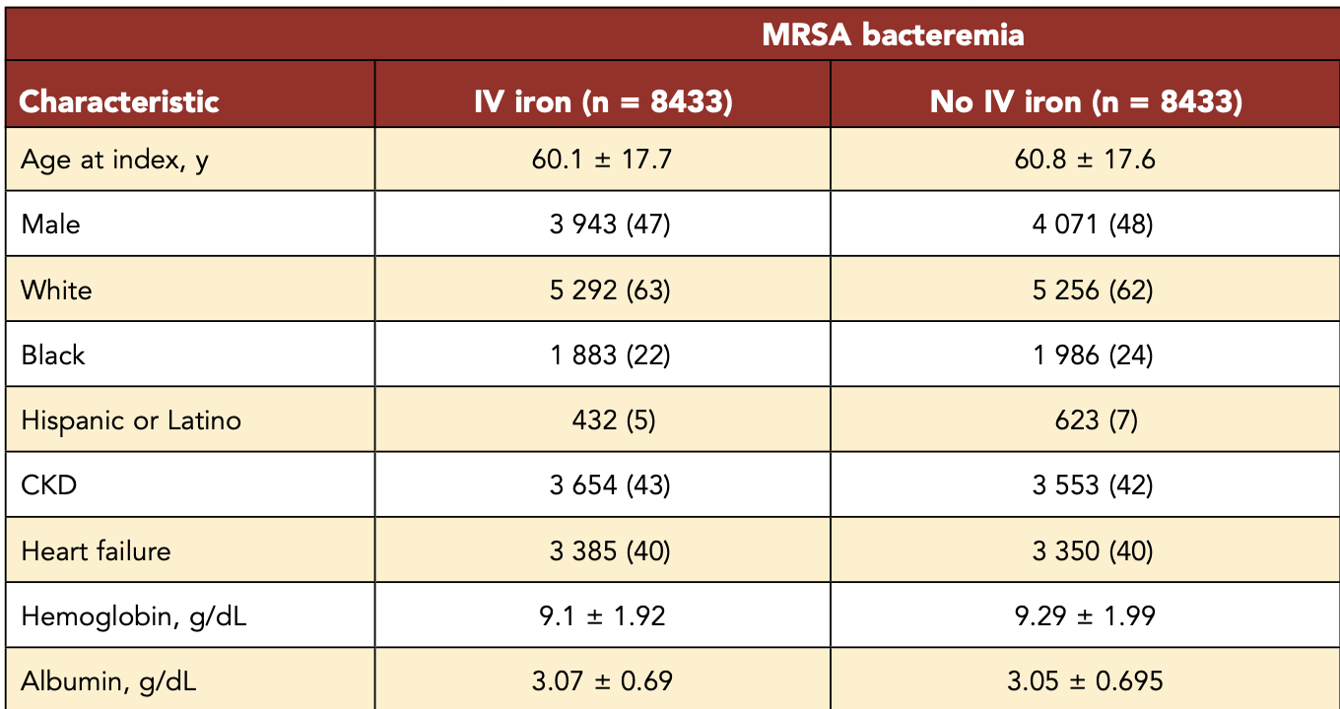
Table 1 revisited
The patients all had MRSA bacteremia. The data come from many hospitals over many years. Individual doctors made the decision if their patient got IV iron. The researchers matched the patients so they had the same average age, race, rates of CKD, Hbg, and other random shit in the data set. Do these groups have prognostic balance?
“We didn’t match on anything about infection severity (inflammatory markers, ICU or floor status, vitals) because we didn’t have that data but we figured why would that matter?” – fake quote

Slide 2
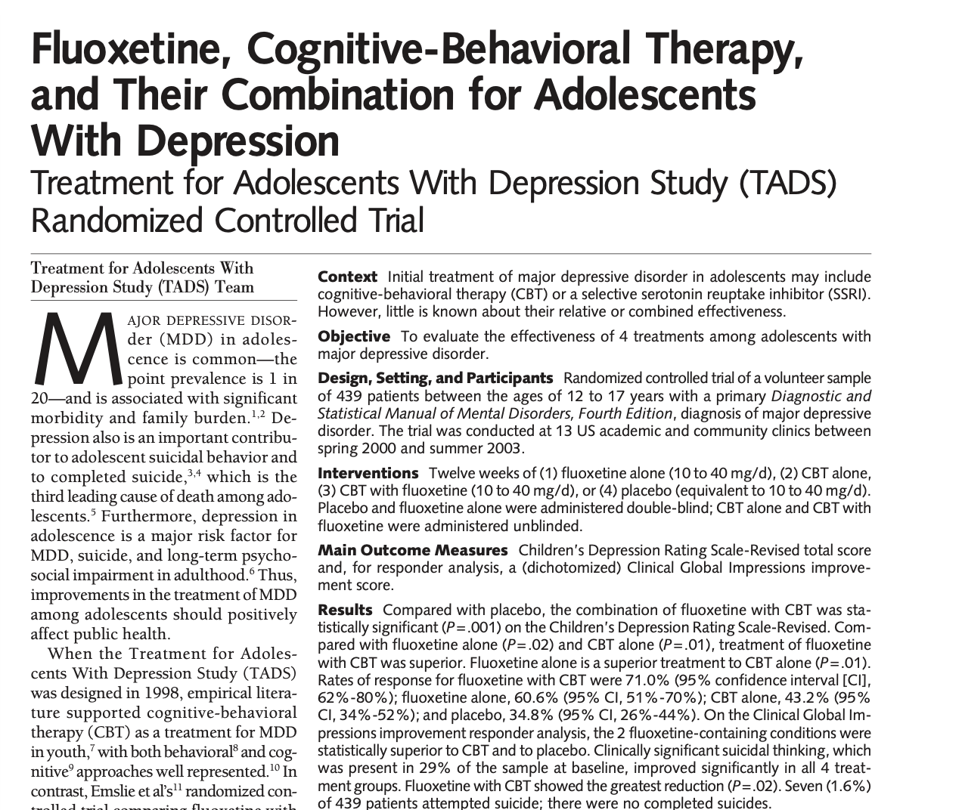
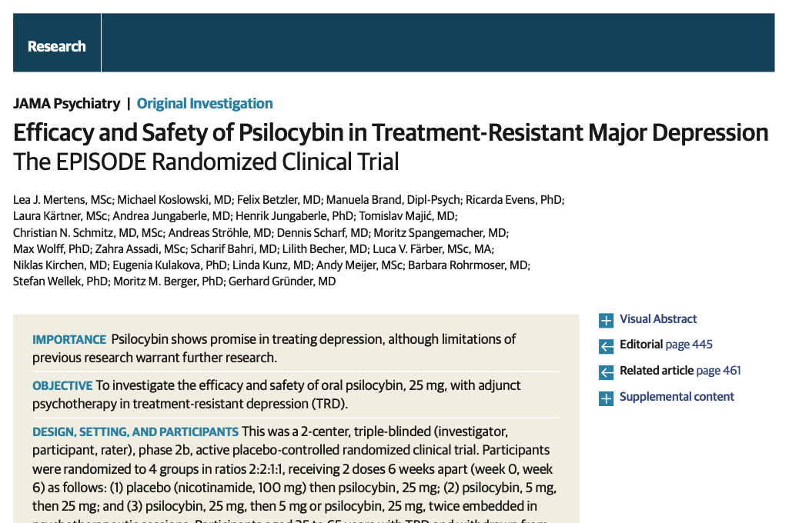
Statistics 101
Steve White

Slide 3
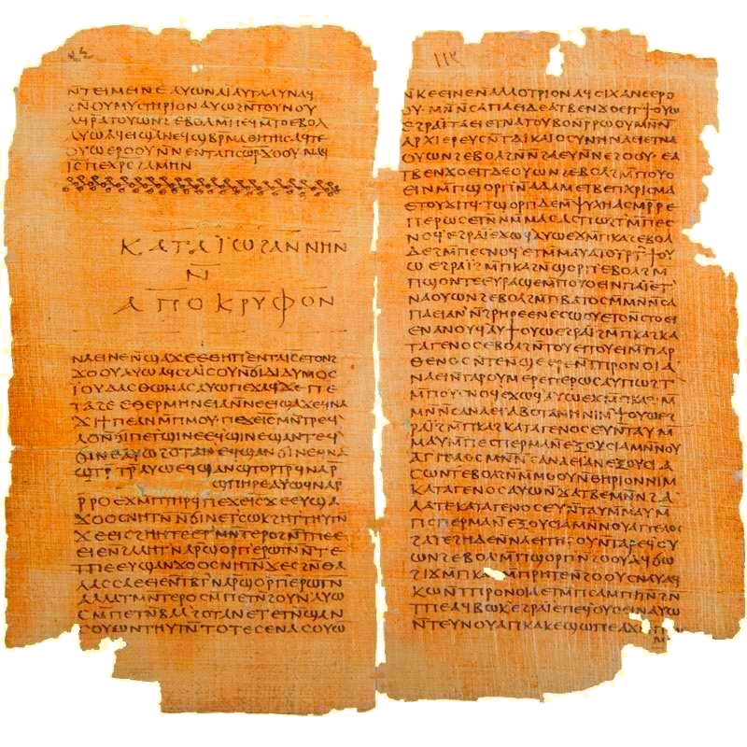
“[statistics] is like a man who wanted to kill a powerful man. He drew the sword in his house and drove it into the wall, that he might know his hand would be strong. Then he slew the powerful man.”
– Gospel of Thomas #98, Blatz translation

Slide 4
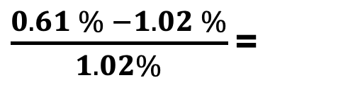
Percentages
RCT of olanzapine (treatment) vs clozapine (control) for suicidal behavior in people w/ schizophrenia.
This was a ______% difference.
 | Olanzapine | Clozapine
suicide attempt | 3 | 5
no attempt | 485 | 487
Total | 490 | 490
Hint:
3/490 = 0.61%
5/490 = 1.02%
0.61% - 1.02% =
0.41pp reduction
“absolute”
$\frac{0.61 \% −1.02 \%}{1.02\%}$ =
40% reduction
“relative”
Source: Meltzer HY, Alphs L, Green AI, et al. "Clozapine Treatment for Suicidality in Schizophrenia: International Suicide Prevention Trial (InterSePT)." Arch Gen Psychiatry. 2003;60(1):82-91.

Slide 5
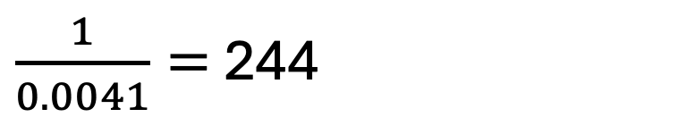

NNT = number needed to treat
NNT = $\frac{1}{absolute risk difference}$
To continue the example, what was the NNT?
But ….
0.61% - 1.02% =
0.41pp reduction
“absolute”
$\frac{1}{0.0041}=$ 244
NNT =

Slide 6
Outline
Is this study informative? (today)
How big is the effect? (August)
Other topics and applications (September)
Two questions today:
Is there is a difference?
Is it a big difference?

Slide 7
Review: Controls
I swear I randomized treatment allocation. I have a computer log that shows the random number generation.
But I lost the intake sheets. I don’t know the intake PHQ-9 scores, gender, history of medication trials, etc. I don’t have $ to gather this information again, so I can’t show you Table 1 and I can’t control for these factors in the study.
Is lacking data on these covariates going to bias my study?

Slide 8
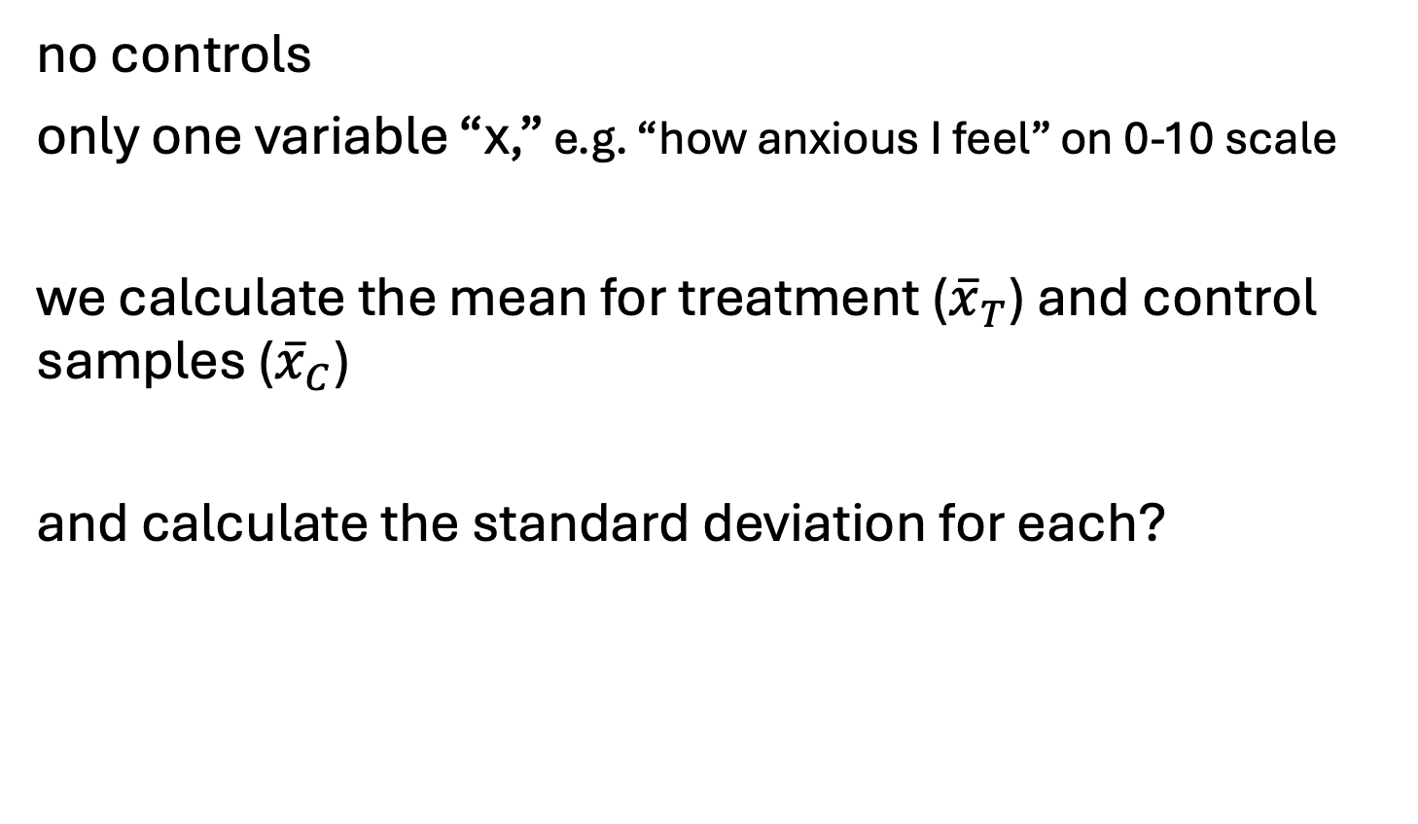
simple prototype study
no controls
only one variable “x,” e.g. “how anxious I feel” on 0-10 scale
we calculate the mean for treatment (${\overline{x}}_{T}$) and control samples (${\overline{x}}_{C}$)
and calculate the standard deviation for each?
wait, wtf is a standard deviation?

Slide 9
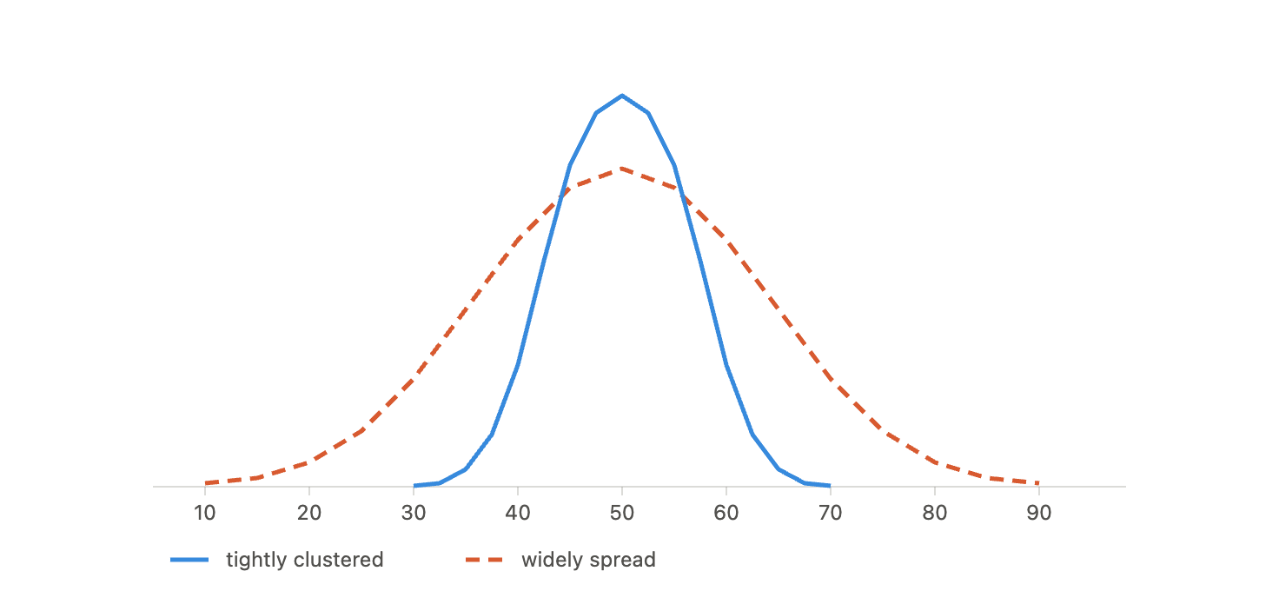
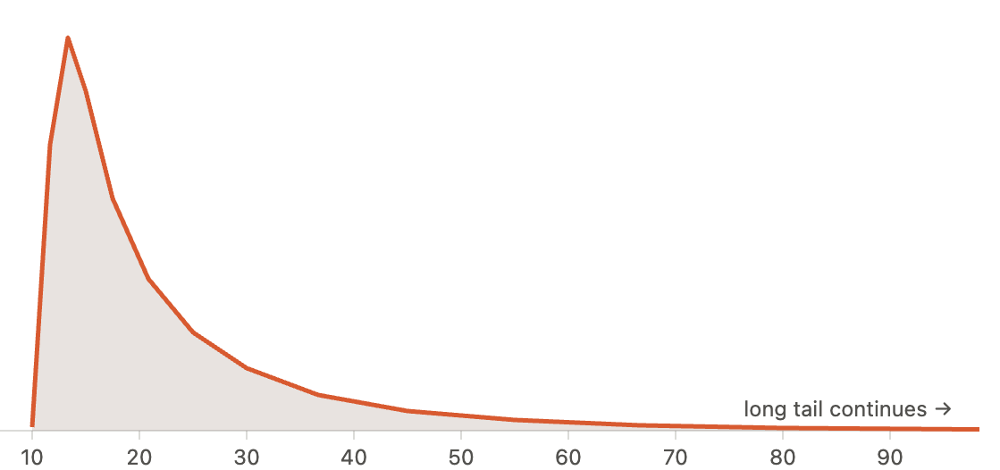
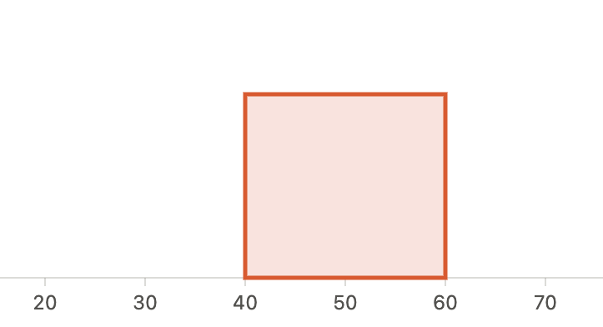
standard deviation (SD)
Rank them based on how spread out they look, from low to high SD.
measure of “spread”

Slide 10
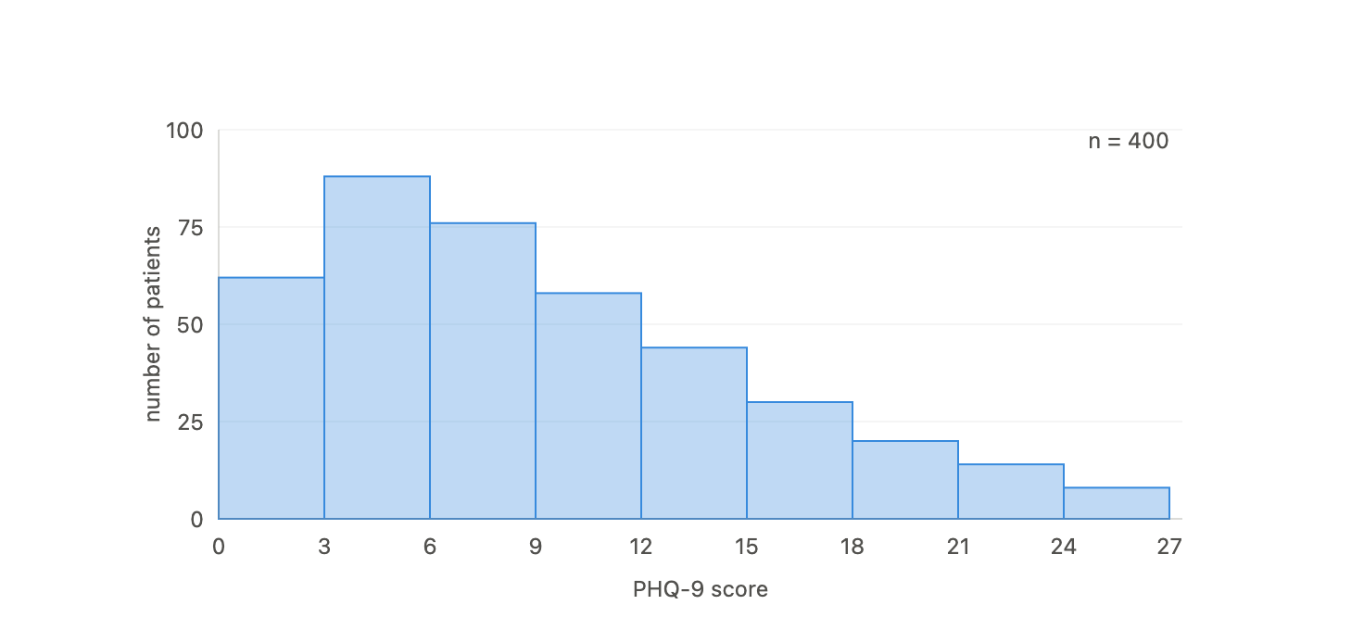


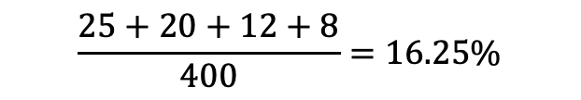
Detour: histogram $⇒$
PHQ-9 scores of OHSU med students*
Prob(PHQ > 15) $≈$
$$\frac{25+20+12+8}{400}=16.25\%$$
(in the sample)
* = made up data, probably realistic

Slide 11
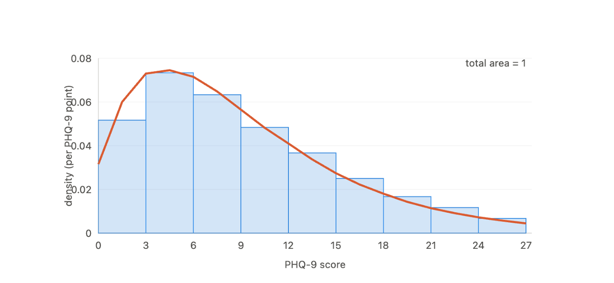

Detour: histogram $⇒$ probability density
PHQ-9 scores of OHSU med students

Slide 12
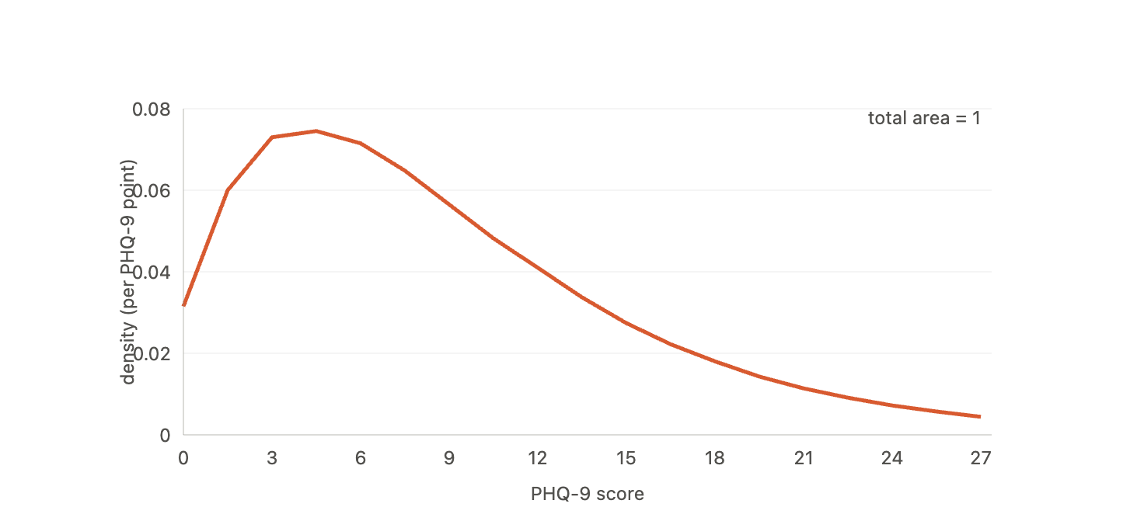

Detour: histogram $⇒$ probability density
PHQ-9 scores of OHSU med students
Prob(PHQ > 15) =
area of
(in the model)

Slide 13
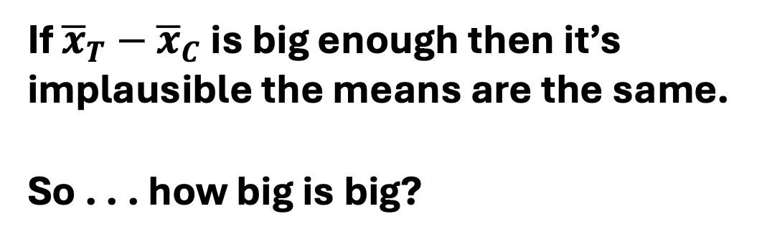
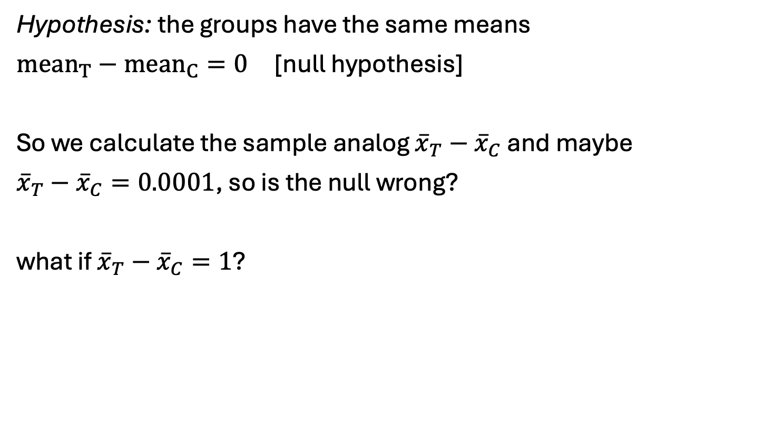
Hypothesis testing
Hypothesis: the groups have the same means
$mean_{T}−mean_{C}=0$ [null hypothesis]
So we calculate the sample analog ${\overline{x}}_{T}−{\overline{x}}_{C}$ and maybe
${\overline{x}}_{T}−{\overline{x}}_{C}=0.0001$, so is the null wrong?
what if ${\overline{x}}_{T}−{\overline{x}}_{C}=1$?
If ${\overline{x}}_{T}−{\overline{x}}_{C}$ is big enough then it’s implausible the means are the same.
So . . . how big is big?

Slide 14

Sampling distribution
Unfortunately, no one can be told what a sampling distribution is. You have to see it for yourself.
https://onlinestatbook.com/stat_sim/sampling_dist/index.html

Slide 15
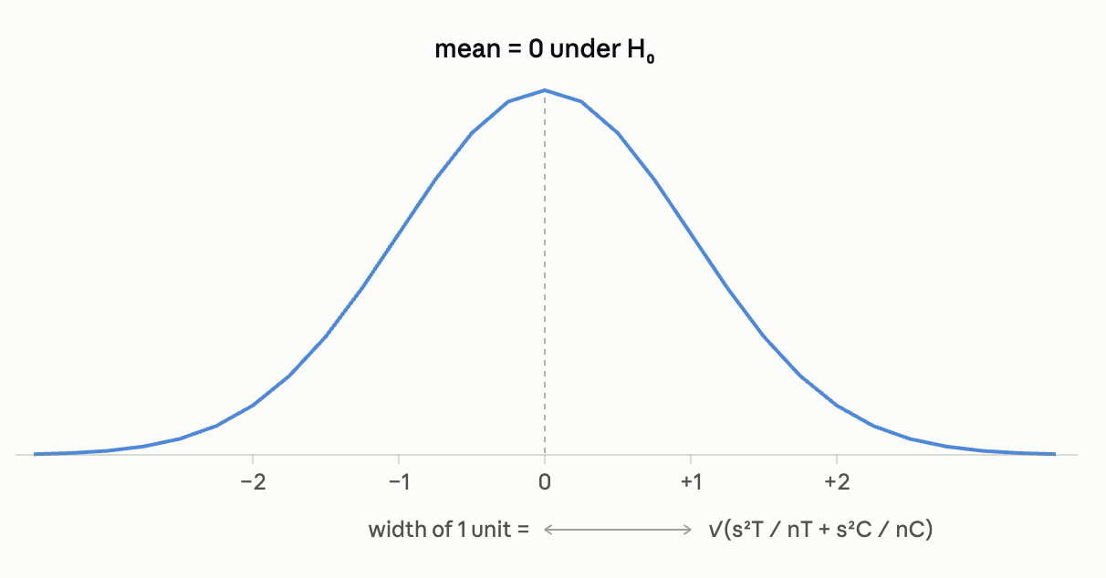

specifics not important, just know its is calculable
${\overline{x}}_{T}−{\overline{x}}_{C}$has a similar sampling distribution . . .
shape: normal/Bell curve
center/mean: 0 (by hypothesis), standard deviation = $\sqrt{\frac{s_{T}^{2}}{n_{T}}+\frac{s_{C}^{2}}{n_{C}}}$

Slide 16
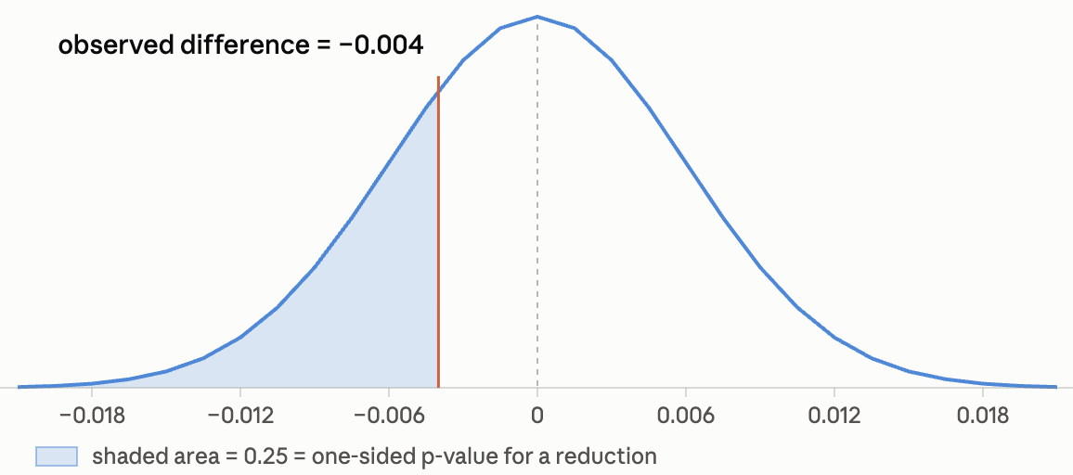

Application: the suicide study
${\overline{x}}_{T}=\frac{3}{490},{\overline{x}}_{C}=\frac{5}{490}$
$$s_{T}≈ s_{C}=0.1 \\ n_{T}=n_{c}=190$$
Could that difference have happened by chance?

Slide 17
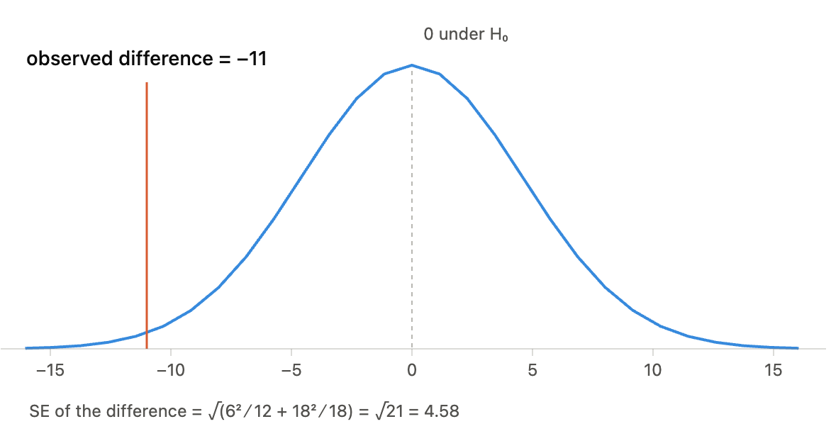

practice #1
${\overline{x}}_{T}=29,{\overline{x}}_{C}=40$
$$s_{T}=6, s_{C}=18$$
$$n_{T}=12, n_{C}=18$$

Slide 18
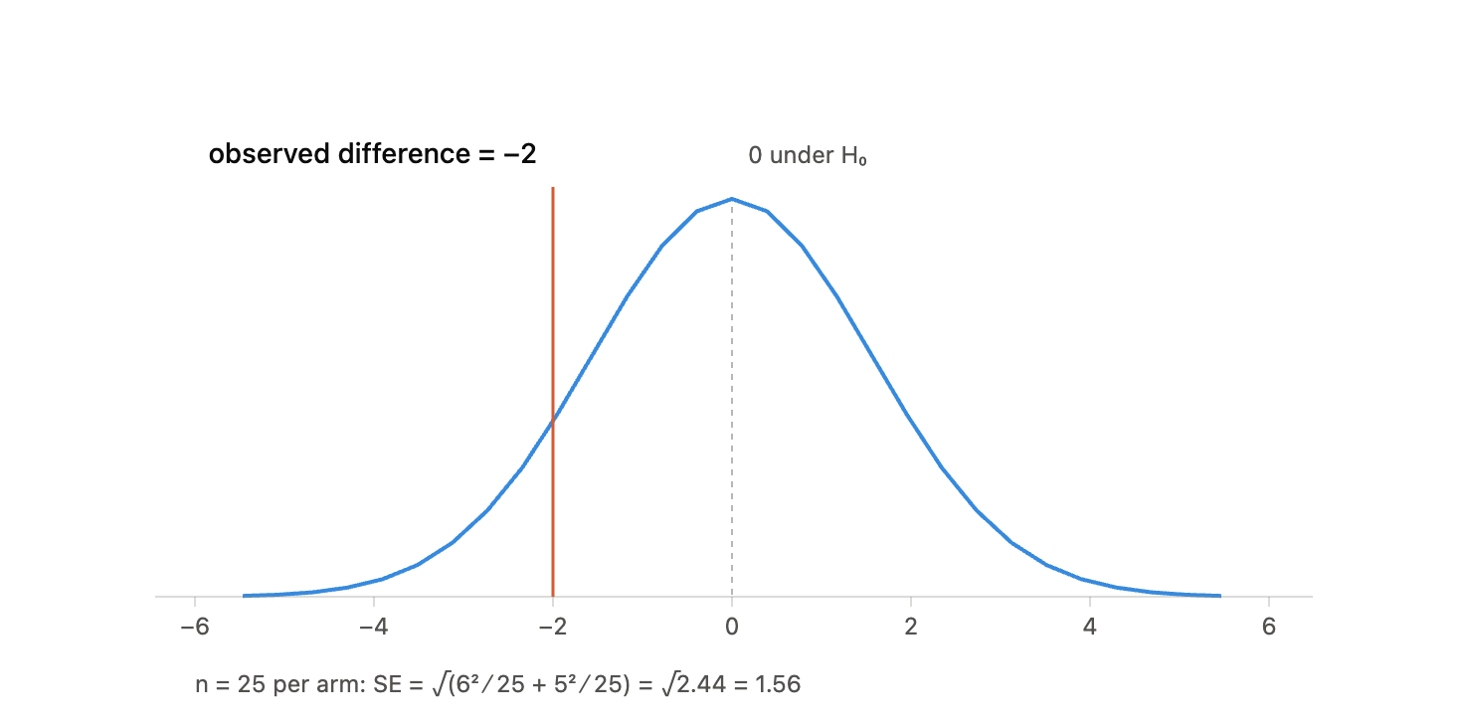

practice #2
${\overline{x}}_{T}=11,{\overline{x}}_{C}=13$
$$s_{T}=6, s_{C}=5$$
$$n_{T}=25, n_{C}=25$$

Slide 19
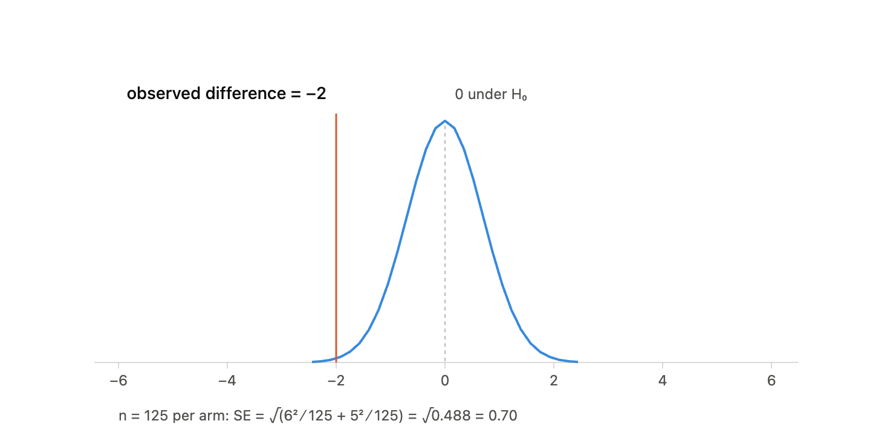

practice #3
${\overline{x}}_{T}=11,{\overline{x}}_{C}=13$
$$s_{T}=6, s_{C}=5$$
$$n_{T}=125, n_{C}=125$$

Slide 20
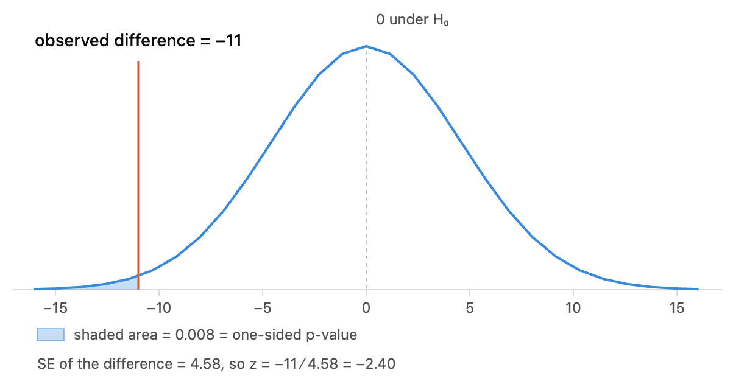
Wouldn’t it be nice to quantify this? not just “it’s low probability” but “the probability of this happening by chance is ___%”
p-value = probability of drawing a result this extreme or more, under the null hypothesis

Slide 21
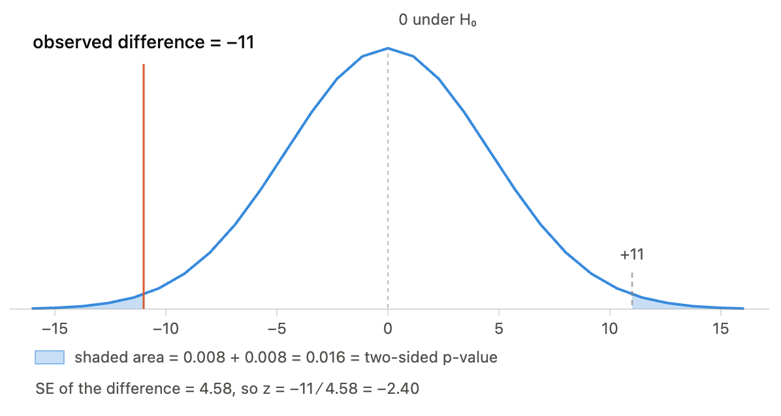
Two-sided P-value
for cases where you’re not sure which group is expected to be better (arguably most of the time)

Slide 22
Statistical significance
The means are are statistically significantly different if the p-value < ______ [arbitrary cutoff, classically 5%]
Key idea: statistical significance means that you observations are improbable if the null is true (e.g. that treatment and control outcomes are the same)

Slide 23
p-value practice
see handout

Slide 24
Clinical Significance
clinical significance means . . .
(like most things where people use the word clinical, if you just drop the word it means the same thing)
Discussion: Return to the handout. Are those statistically significant effects clinically significant?

Slide 25
Confidence intervals (if time)
Our process so far:
(1) start with hypothesized difference of 0
(2) ask if data reject it (at p = ____ threshold)
Alternative: list out all hypothesized differences the data would NOT reject at p = _____ threshold
website to illustrate
Notes:
0 isn’t in CI = reject null, tautological

Slide 26
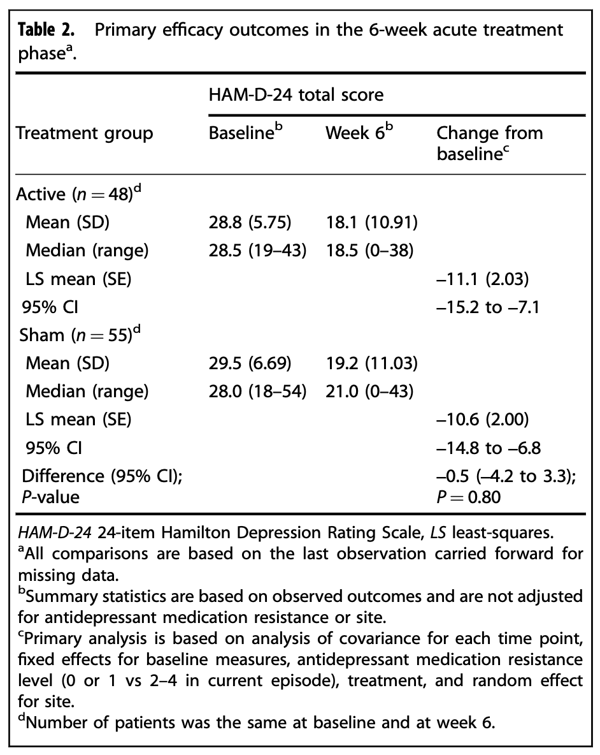
Discussion (if time)
Evaluate this claim: “this study showed that TMS is not effective as a treatment in this population”
Croarkin et al. from the handout

Slide 27
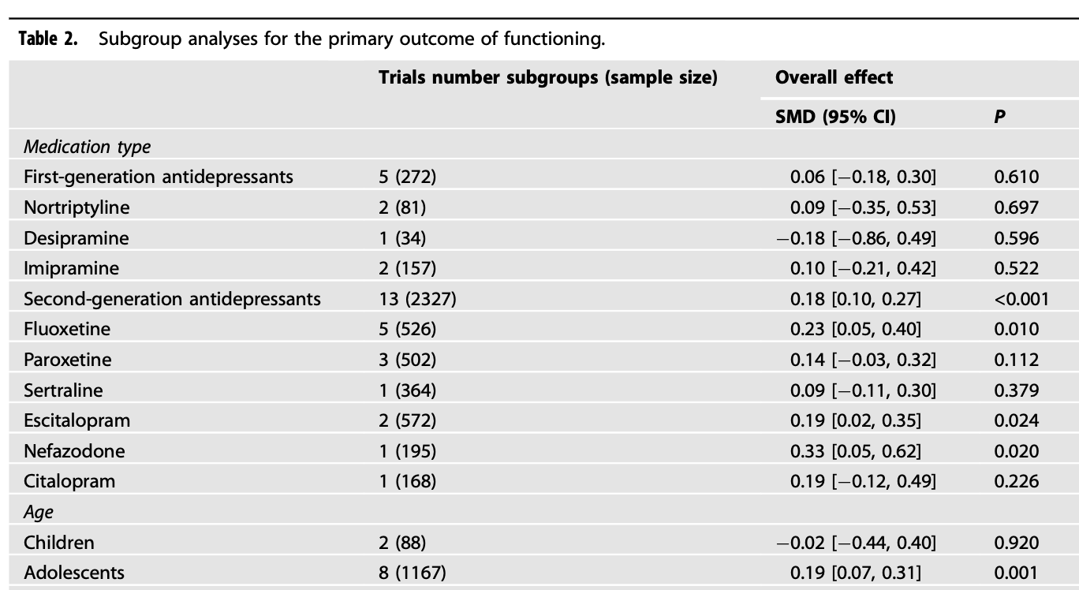
Practice (if time)
Evaluate these claims:
The drugs improve functioning for adolescents but not for children.
These data show that second-generation antidepressants work better than first-generation antidepressants.
doi:10.1038/s41398-022-01951-9

Slide 28

Summary
Is this difference plausibly just due to chance?
use p-value to assess the probability
statistical significance
Is this difference a big deal?
use your brain!

Slide 29
Summary (continued)
Use pp (percentage point) vs % notation to make it clear when you’re discussing relative vs absolute changes
NNT = 1/(pp. difference), NNH is the same thing
standard deviation = a measure a “spread”
Sampling distribution. Play with the tool to understand it.
p-value = probability of getting this extreme (or more) of a difference assuming the null is true
statistical significance is about whether the data are plausible assuming the null is true. clinical significance is about whether observed differences matter.
confidence intervals list all the “null” hypotheses that would NOT be rejected by the observed data.
“absence of evidence isn’t evidence of absence”

Slide 30
Multiple comparisons (if time)
find an authentic example via claude
ask students what is wrong here?
pre-specification should be done if doing lots of comparisons

Slide 31
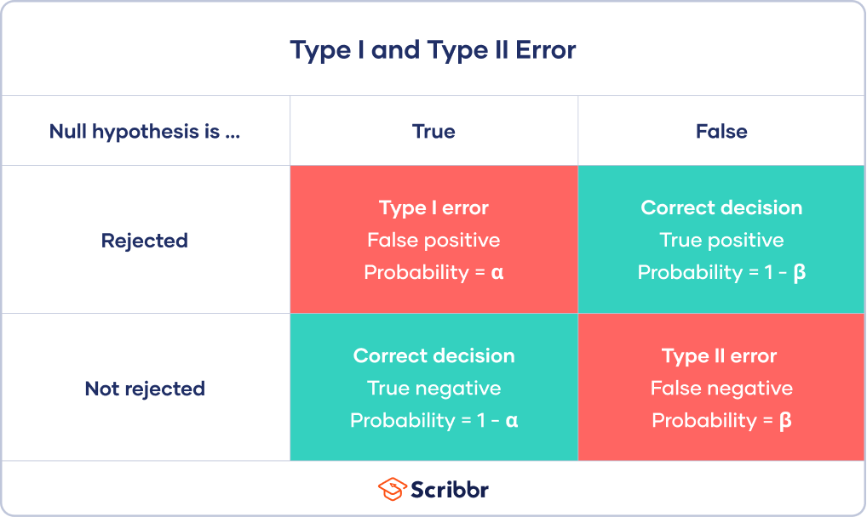
Errors in hypothesis testing
These are analogous to errors in diagnostic testing
FALSE POSITIVE
FALSE NEGATIVE

Slide 32
Power
Power = prob. of NOT having a false negative for a given T-C difference and sample size
What is a potential problem if this study was underpowered?
A new treatment for anxiety shows no statistically significant impact in a new RCT. You conclude it won’t help your patients.

Slide 33
“absence of evidence isn’t evidence of absence”
Explain it to a friend.
Your cat.
Your mom.

Slide 34
Power (continued)
Weird other consequence of underpowered studies is that when they do show statistical significance the effect is massively inflated. [any real world examples]

Slide 35
Power practice (if time)
Can punt to next time
suicide application – pediatric trial size needed to determine X therapy reduces suicide
contrast with suicidal behavior

Slide 36
Effect size
Effect size = (mean difference) / standard deviation
Often denoted d or g
[clarify these difference]
For simple models it’s easy to calculate the sample you need to get 80% power based on effect size:
Rule of thumb:16/d^2 per group
Application to InterSept -> ~170

Slide 37

It’s a trap!
Some people use effect sizes as a measure of clinical significance.
[examples]
Those people are retarded.

